Slide 1
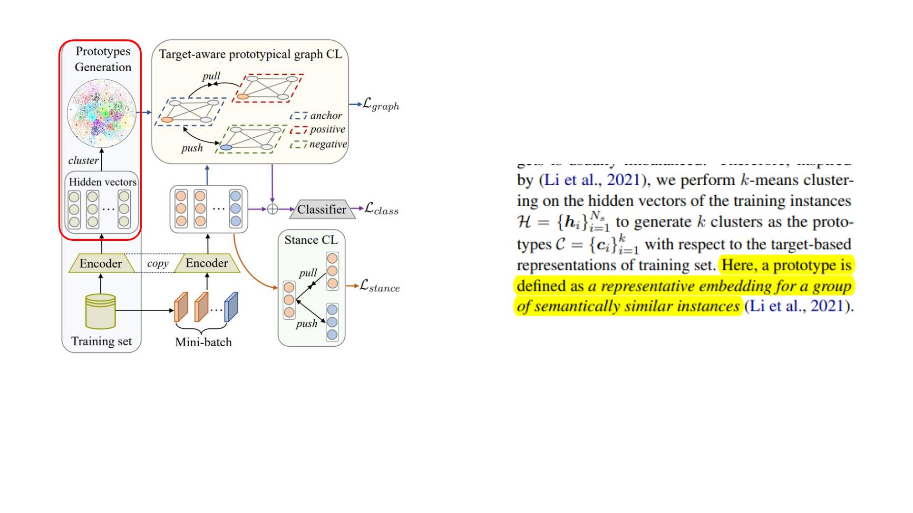
2022_ACL_JointCL: A Joint Contrastive Learning Framework for Zero-Shot Stance Detection
Code:https://github.com/HITSZ-HLT/JointCL

Slide 2
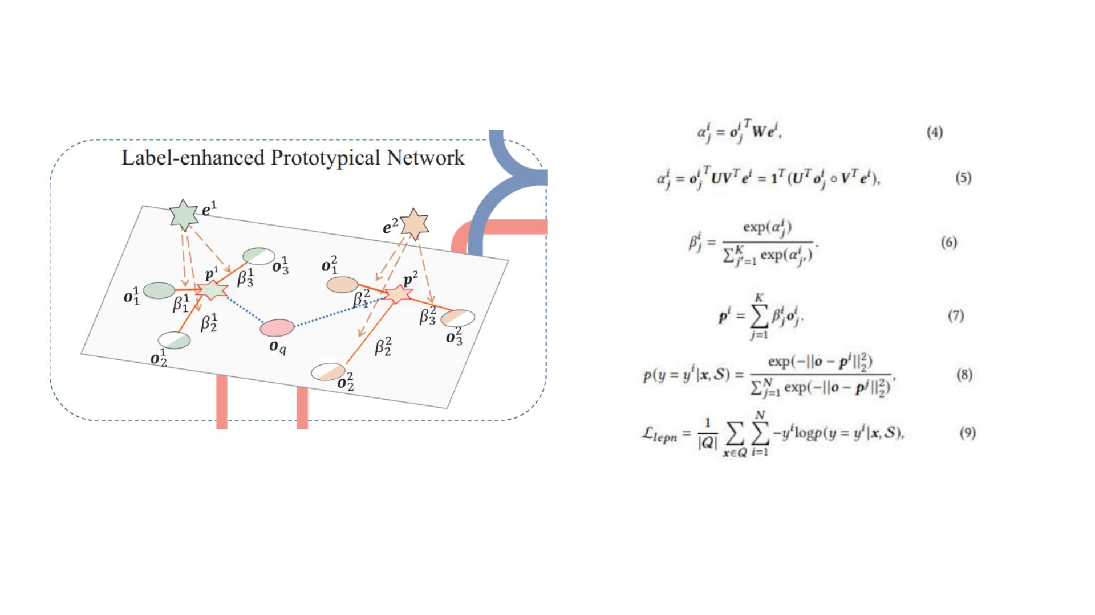
2022_KDD_Label-enhanced Prototypical Network with Contrastive Learning for Multi-label Few-shot Aspect Category Detection

Slide 3
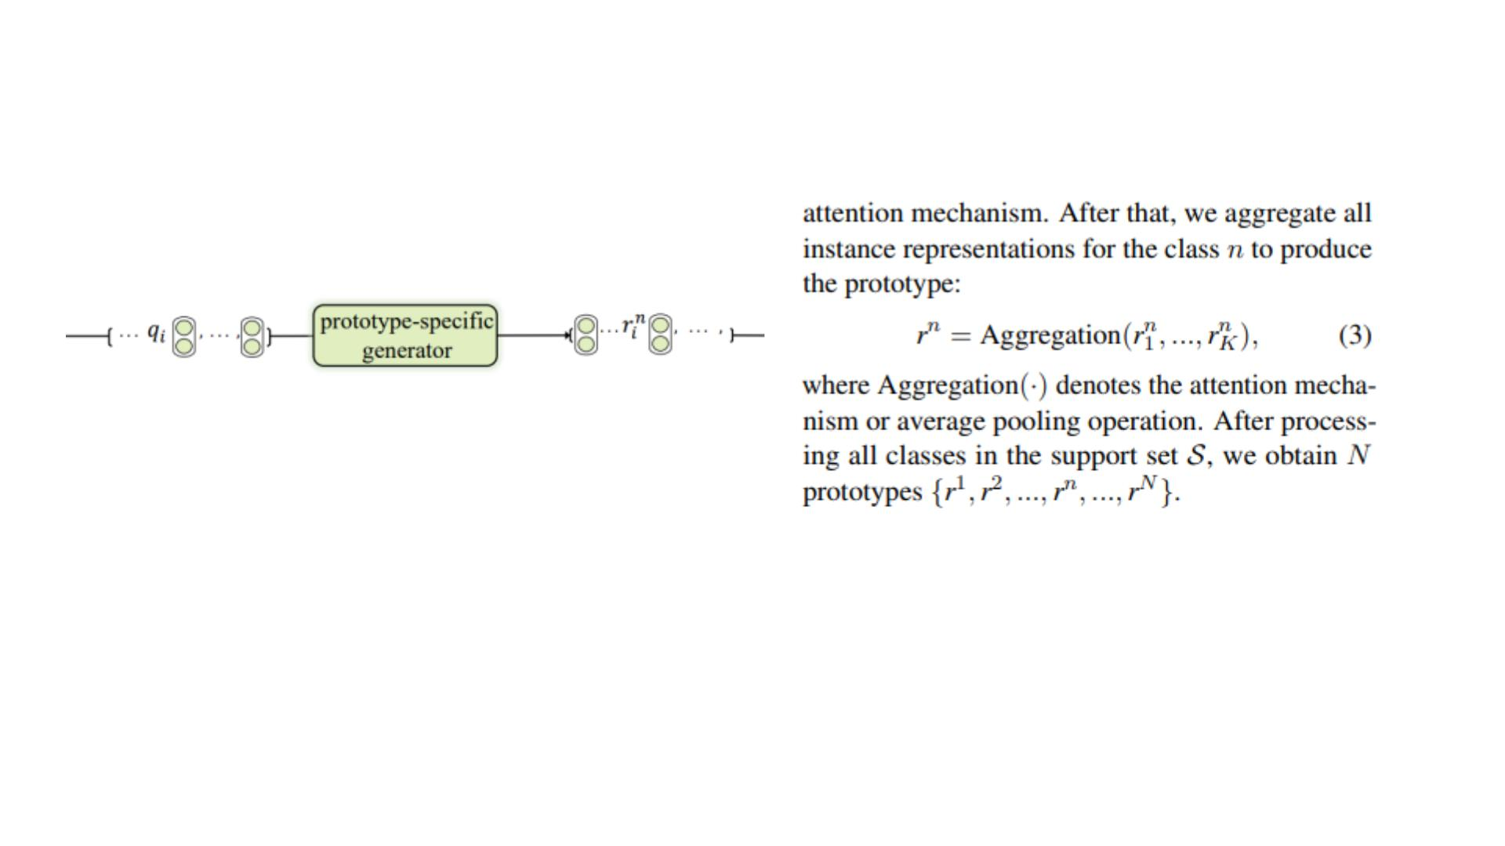
Label-Driven Denoising Framework for MultiLabel Few-Shot Aspect Category Detection
https://github.com/1429904852/LDF

Slide 4
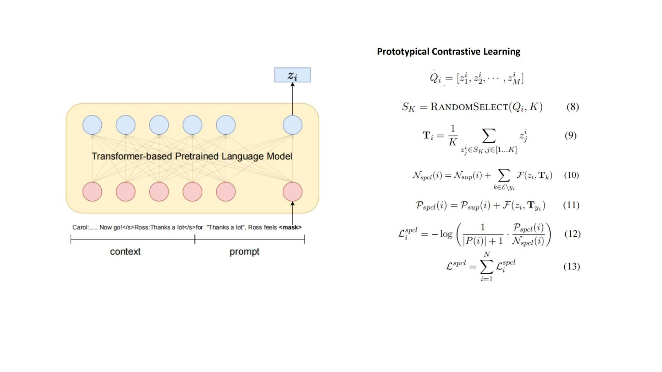
2022_EMNLP_Supervised Prototypical Contrastive Learning for Emotion Recognition in Conversation
https://github.com/caskcsg/SPCL

